Slide 1
21
Notes:
Which vendor wouldn’t want this?

Slide 2
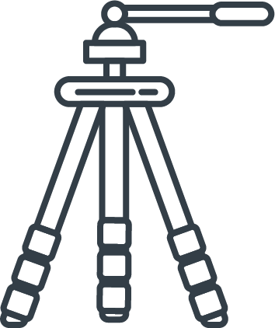


Professional
Photography.
We send a professional photographer to
capture the property in its best possible light, adding striking enhancements afterwards,
so it stands out online.
97% of property searches start online – why wouldn’t you make a great first impression?

Slide 3
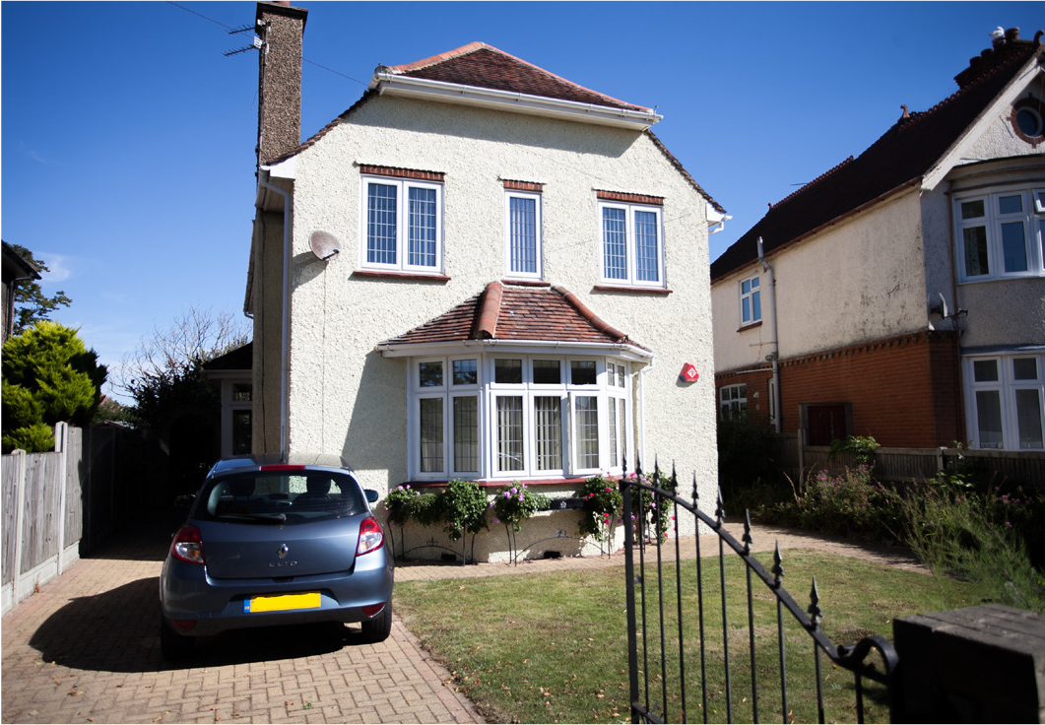
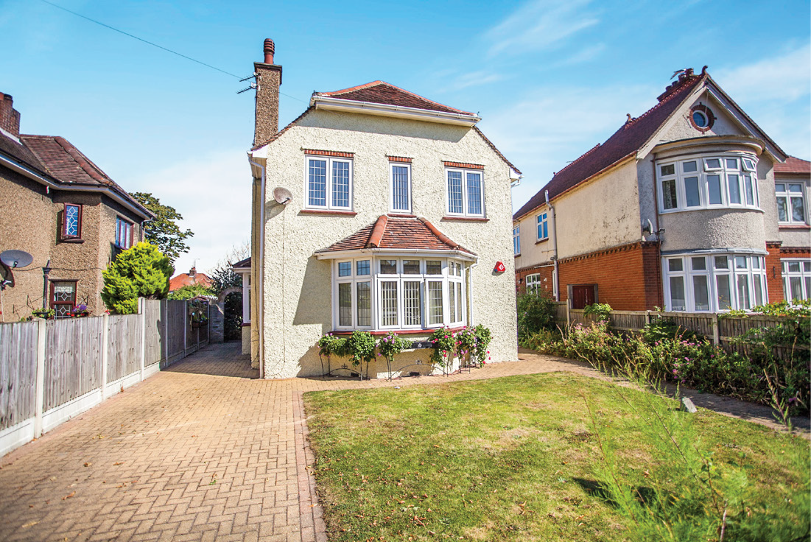


Instruction winning professional photography that differentiates you from your competition.
NON PROFESSIONAL
PROFESSIONAL
THE DIFFERENCE…

Slide 4
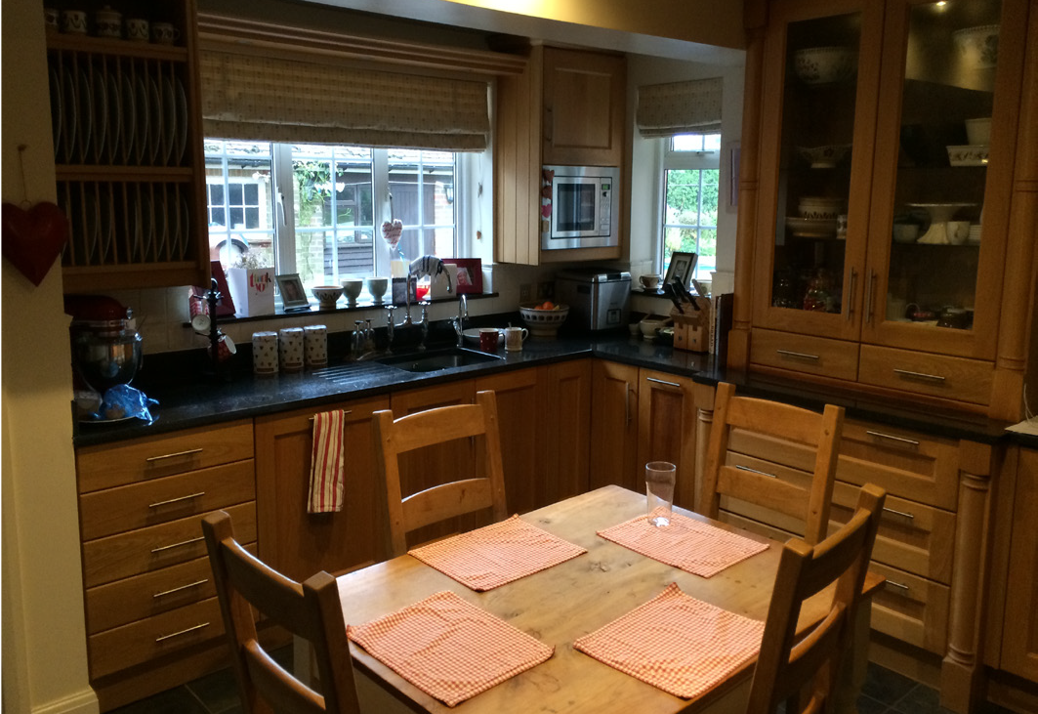
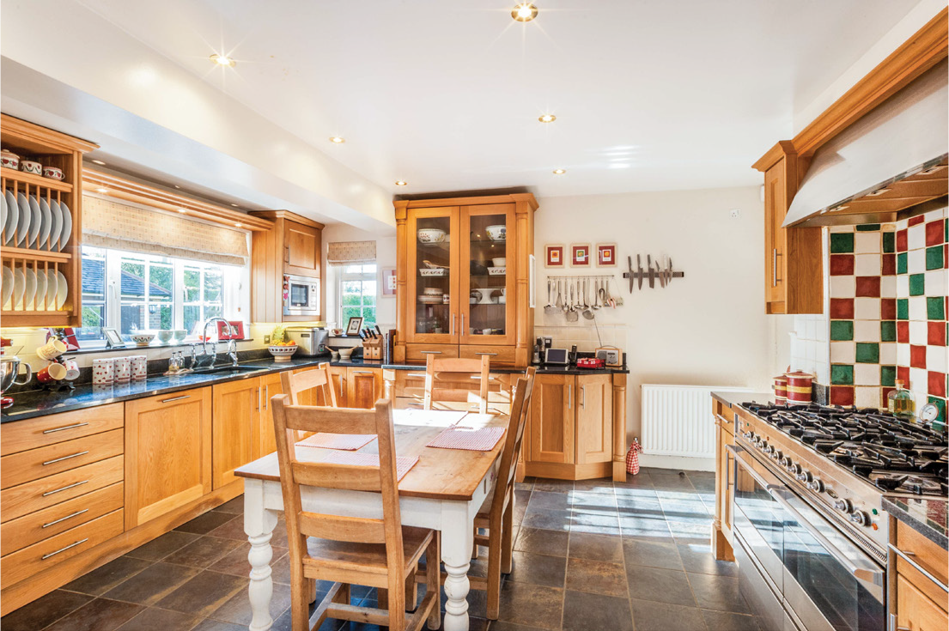
Instruction winning professional photography that differentiates you from your competition.
NON PROFESSIONAL
PROFESSIONAL
THE DIFFERENCE…
Notes:
Home staging reminders and engaging vendors in the process

Slide 5

STAND OUT FROM COMPETITORS ONLINE
Video Trailers.
ATTRACT MORE
OUT-OF-AREA BUYERS
Low cost, high quality videos with up to
60 seconds of content with professional voiceover. Showcasing the property & local area to engage prospective buyers and tenants
INCREASE BRAND & VIEWER ENGAGEMENT
FACT:
90% of our viewers watch video trailers all the way
to the end!
Notes:
The difference between video trailers and 360 and why are both so important in their own right

Slide 6
20% OF BUYERS WOULD IGNORE PROPERTIES
WITHOUT A FLOOR PLAN
Floor Plans.
HELP BUYERS & APPLICANTS VISUALISE THE SPACE
Floor plans offer structure to the photos, allowing the buyer to understand the layout and flow of the property in a single frame
A FLOOR PLAN LEAD TO A CLICK-THROUGH INCREASE OF 52%
FACT:
Get 30% more qualified enquiries with a floor plan!
Notes:
Don’t want to miss any buyers

Slide 7
UNDERSTAND THE
LAYOUT & FLOW
360 Tours.
FEEL LIKE YOU ARE
AT THE PROPERTY
Immerse more viewers with 360° visual content and explore even more of a property!
ENGAGE MORE
VIEWERS FOR LONGER
FACT:
360 tours attract higher quality applicants
CAPTURE MORE
OF THE PROPERTY
Notes:
Cover front end pitch importance as well as attracting buyers/future vendors. Cover how best to utilise them.

Slide 8
ENHANCED APPLICANT QUALIFICATION
Following our Smart First approach
Smart
Viewing.
RELEASE VALUABLE TIME TO BUSINESS GENERATION
Physical viewing 1Hr vs Smart First 10 Mins*
An interactive platform where an applicant is walked and talked through a property while neither of you is actually there!
REDUCE VIEWING TO OFFER RATIO
35% Improvement / Buyer more likely to offer on first physical If following a Smart First viewing
FACT:
Saves time, saves money, & increases efficiency.
GAIN MARKET SHARE
Vendors feel safer with Smart First
New Instructions generated from Smart First
*Smart First virtual viewings on average cover 2 properties

